Slide 1




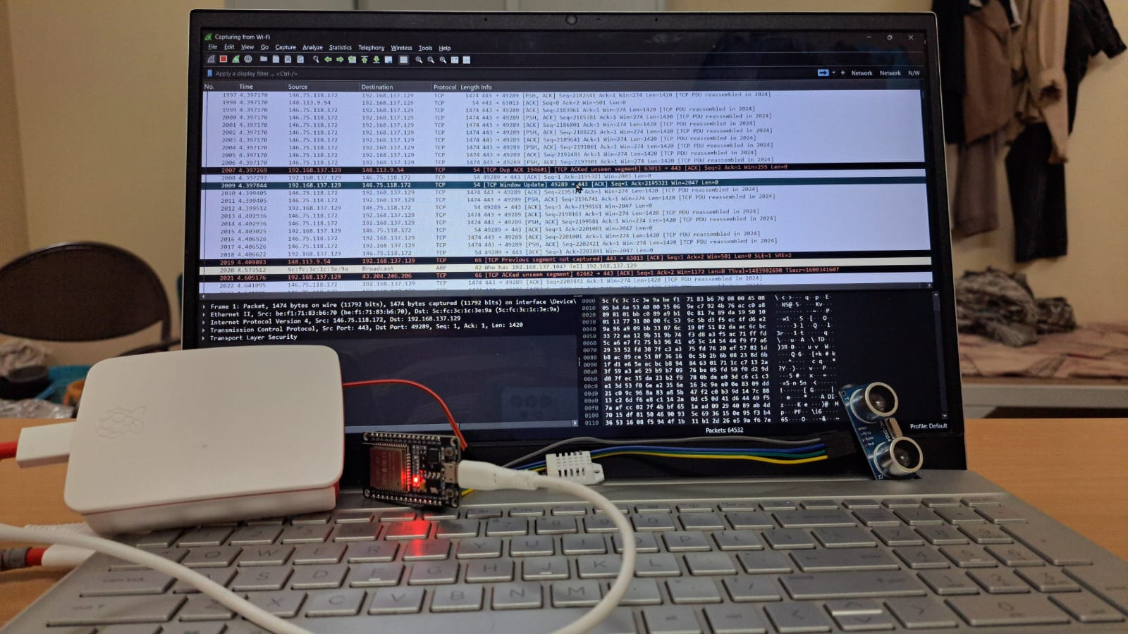

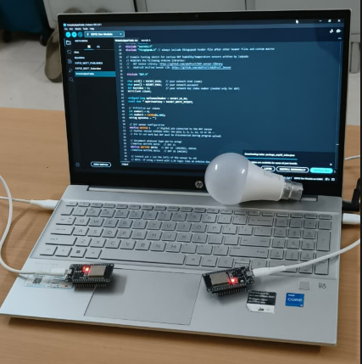
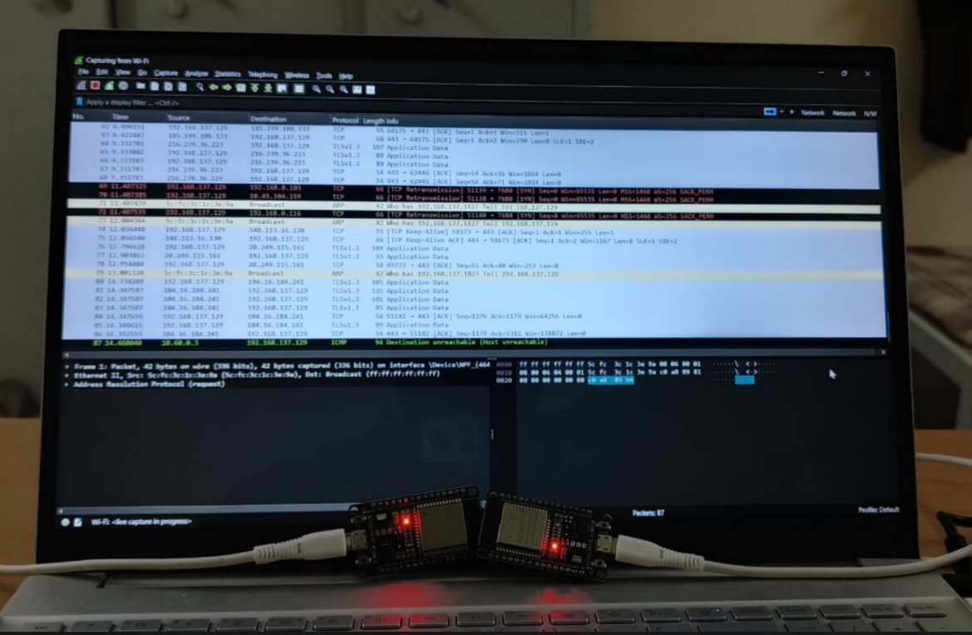




OPEN HOUSE’26
An Intelligent Smart Home IoT Security System for Threat Detection, Classification, and Alert Mechanisms
PROBLEM STATEMENT
WORKING PROTOTYPE
IoT devices such as smart bulbs are vulnerable to cyberattacks due to limited security mechanisms. There is a need ,for an intelligent system to monitor network traffic detect abnormal behavior, and identify different types of attacks in IoT networks.
¡¡
ABSTRACT
This project proposes a machine learning-based intrusion detection system for smart bulb networks. The system analyzes network traffic to detect abnormal behavior and identify different types of cyberattacks. An anomaly detection model first identifies suspicious traffic patterns, and a classification model then determines the specific attack type. This approach improves IoT network security by enabling automated monitoring and attack detection.
¡¡
¡¡
METHODOLOGY & TECHNICAL STACK
RESULTS
Methodology
• Collect IoT network traffic datasets. • Preprocess data (cleaning, encoding, scaling, feature selection). • Train anomaly detection model to detect abnormal traffic. • Train classification model to identify attack types. • Test the system on new network traffic data.
Technical Stack
• Programming Language: Python • Libraries: Pandas, NumPy, Scikit-learn, TensorFlow, Matplotlib • Algorithms: Local Outlier Factor (LOF), Random Forest • Tools: CSV datasets, Python environment
Successfully implemented a smart home IoT environment using ESP32 and a smart bulb communicating over Wi-Fi.
Successfully captured normal IoT network traffic and generated attack traffic through simulated network attacks.
Successfully preprocessed and analyzed network traffic data to identify behavioral patterns.
Successfully compared multiple anomaly detection models and selected the best-performing model.
Successfully detected abnormal IoT network traffic and classified different types of attacks using machine learning.
CONCLUSION
G Abhishek Goud
G Sai Srujith
V Pavan Kumar
Y Saketh
TEAM
The project demonstrates a machine learning–based system for monitoring IoT smart bulb network traffic and detecting malicious activities. The system can identify abnormal traffic and classify different attack types, helping improve security in smart home IoT environments.

